Slide 1
PROGRAMMING USING C

Slide 2
Computers
Computer is a fast electronic calculating machine that accepts digitized input information, processes it according to a list of internally stored instructions, and produces the resulting output information

Slide 3
Types of Computers
Desktop or Personal computers
Workstations- high resolution graphics I/O capability and more computational power
Mainframes – used for business data processing-more computational power and storage capacity
Servers- capable of handling large volume of requests to access the data
Super computers (Prathush, Mihir)

Slide 4
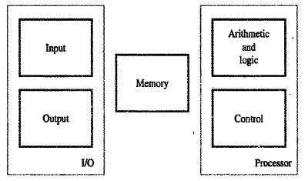
Functional Units
Five functionally independent components
Input Unit
Output Unit
Memory Unit
Arithmetic and logic Unit
Control Unit

Slide 5
Summary
Operations of a computer:
Accept information in the form of programs and data through an input unit and store it in the memory
Fetch the information stored in the memory, under program control, into an ALU, where the information is processed
Output the processed information through an output unit
Control all activities inside the machine through a control unit

Slide 6
Topic : Algorithms , Pseudocode and Flowcharts

Slide 7
What is an Algorithm?
An algorithm is a sequence of steps to solve a particular problem
An algorithm is a collection of well-defined, unambiguous and effectively computable instructions, if executed it will return the proper output.

Slide 8
Well-defined- The instructions given in an algorithm should be simple and well specified.
Unambiguous- The instructions should be clear , there should not be ambiguity .
Effectively computable- The instructions should be written step by step ,which helps computer to understand the control flow

Slide 9
An algorithm has the following characteristics :
Input: An algorithm may or may not require input
Output: Each algorithm is expected to produce at least one result
Definite: Each instruction must be clear and unambiguous
Finite: If the instructions of an algorithm are executed, the algorithm should terminate after finite number of steps

Slide 10
Building Blocks of Algorithm
Any algorithm can be constructed using three basic building blocks.
These three building blocks are
Sequence (Action)
Selection (Decision)
Iteration (Repetition)

Slide 11
Sequence
This describes a sequence of actions that a program carries out one after another, unconditionally. Execute a list of statements in order.
Selection
Selection is the program construct that allows a program to choose between different actions. Choose at most one action from several alternative conditions.
Repetition
Repetition (loop) may be defined as a smaller program that can be executed several times in a main program. Repeat a block of statements while a condition is true.

Slide 12
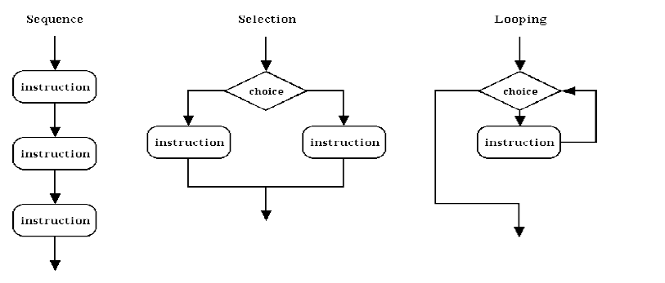
NO
YES
NO
YES

Slide 13
Advantages of Algorithm
It is a step-wise representation of a solution to a given problem, which makes it easy to understand.
An algorithm uses a definite procedure.
It is not dependent on any programming language, so it is easy to understand for anyone even without programming knowledge.
Every step in an algorithm has its own logical sequence so it is easy to debug.

Slide 14
Examples
Algorithm for Addition of two numbers
Step 1: Start
Step 2: Get two numbers ‘a’ and ‘b’ as input
Step 3: Add the numbers ‘a’ & ‘b’ and store it into ‘c’
Step 4: Print ‘c’
Step 5: Stop.

Slide 15
Algorithm to find biggest among 2 numbers
Step 1 :Start
Step 2: Get two numbers as input and store it into ‘a’ and ‘b’
Step 3: If ‘a’ is greater than ‘b’ then
Step 4: Print ‘a’ is big
Step 5: else
Step 6: Print ‘b’ is big
Step 7: Stop

Slide 16
Algorithm to calculate factorial
Step 1: Start
Step 2: Read the number num.
Step 3: Initialize i = 1 and fact = 1
Step 4: Repeat step 4 through 6 until i is equal to num
Step 5: fact<--fact * i
Step 6: i←-i+1
Step 7: Print fact
Step 8: Stop

Slide 17
Pseudo Code

Slide 18
Pseudo Code
“Pseudo” means imitation or false and “code” refers to the instructions written in a programming language.
Pseudocode is another high-level representation used for planning a program
Pseudocode is also called Program Design Language(PDL)

Slide 19
Pseudo code
Pseudo code is a detailed yet readable description of what a computer program or algorithm must do, expressed in a formally-styled natural language rather than in a programming language.
Pseudo code is sometimes used as a guideline in the process of developing a program

Slide 20
Guidelines to write Pseudocode
Pseudocode is written using structured English.
Pseudocode should be concise
Keyword should be in capital letter

Slide 21
Examples
Pseudocode to add two numbers:
START
READ a , b
COMPUTE c=a + b
PRINT c
STOP

Slide 22
Pseudocode to find biggest among 2 numbers
START
READ a and b
IF a>b THEN
PRINT “A is big”
ELSE
PRINT “B is big”
ENDIF
STOP

Slide 23
Flowcharts

Slide 24
Flowcharts
A flowchart is a visual representation of sequence of steps and decision needed to perform a process.
Flow charts are easy-to-understand diagrams that show how the steps of a process fit together
Flowchart can be used to
Demonstrate the way code is organized.
Visualize the execution of code within a program.
Specify the method of solving a problem
Understand the flow of the process or an algorithm

Slide 25
Symbols of Flowchart

Slide 26
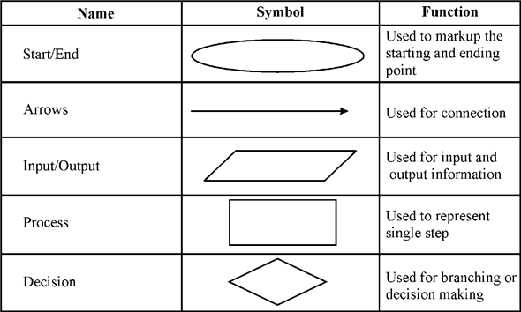

Slide 27
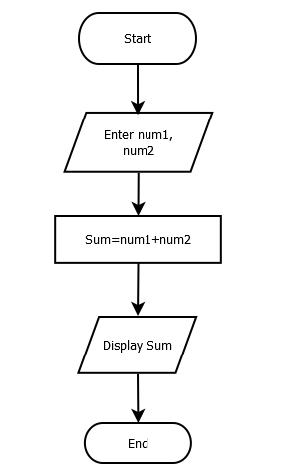
Flowchart to find sum of two numbers

Slide 28
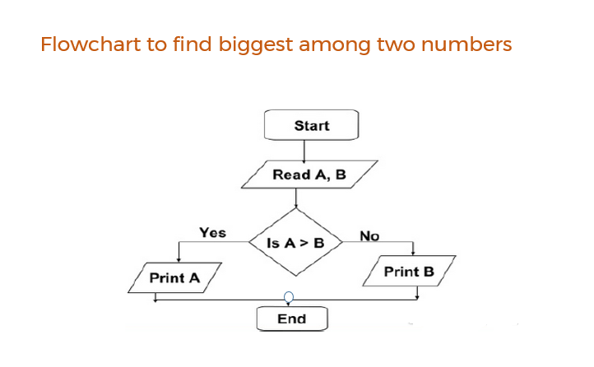

Slide 29
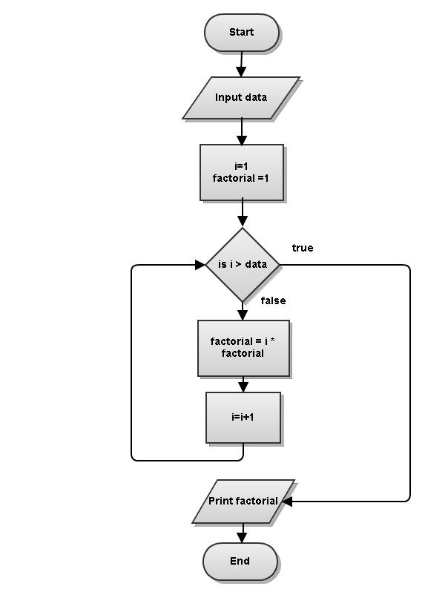
Flowchart for finding the factorial of a number

Slide 30
Programs and Programming

Slide 31
Programming
Programming is the process of taking an algorithm and encoding it into a notation, a programming language, so that it can be executed by a computer.

Slide 32
Program
A computer program is a collection of instructions that can be executed by a computer to perform a specific task.

Slide 33
Algorithmic Problem Solving

Slide 34
Algorithmic Problem Solving
Algorithmic-problem solving means solving problems that require the formulation of an algorithm for their solution.
The formulation of algorithms have always been an important element of problem-solving .

Slide 35
An algorithmic Development Process
An algorithm development process consists of five major steps.
Step 1: Obtain a description of the problem.
Step 2: Analyze the problem.
Step 3: Develop a high-level algorithm.
Step 4: Refine the algorithm by adding more detail.
Step 5: Review the algorithm.

Slide 36
Simple Strategies for Developing Algorithm

Slide 37
Iteration
Iteration is a process wherein a set of instructions or structures are repeated in a sequence, a specified number of times or until a condition is met
Once a problem is clear then the logic of the solution could be implemented using an iteration where it could run multiple times to achieve a specific outcome

Slide 38
Example: To Find the factorial of a number(An algorithm using Iteration)
Step 1: Start
Step 2: Get a number from the user and store it in variable given_number
Step 3: Initialize variables start and storage with 1.
Step 4: Repeat Until start is less than or equal to the given_number
Step 5: Multiply start with storage and store the result in variable storage
Step 6: Increase the value of start with 1 and go to step 4
Step 7: Display the value of storage as the factorial of the given number.

Slide 39
Recursion
A function that calls itself is known as recursion.
Recursion is a process by which a function calls itself repeatedly until some specified condition has been satisfied.

Slide 40
Algorithm for factorial of n numbers using recursion:
Main function:
Step1: Start
Step2: Get n
Step3: call factorial(n)
Step4: print fact
Step5: Stop
Sub function factorial(n):
Step1: if(n==1) then fact=1 return fact
Step2: else fact=n*factorial(n-1) and return fact

Slide 41
Introduction to C Programming

Slide 42
History of C
ALGOL 1960 International Group
BCPL 1967 Martin Richards
B 1970 Ken Thompson
C 1972 Dennis Ritchie
1

Slide 43
History of C --- contd..
K&R C 1978 Kernighan & Ritchie
ANSI C 1989 ANSI committee
(American National Standards Institute)
ANSI/ISO C 1990 ISO committee
(International Standards Organization)
1

Slide 44
WHY LEARN C?
C is easy to learn
C is portable
C is middle level language

Slide 45
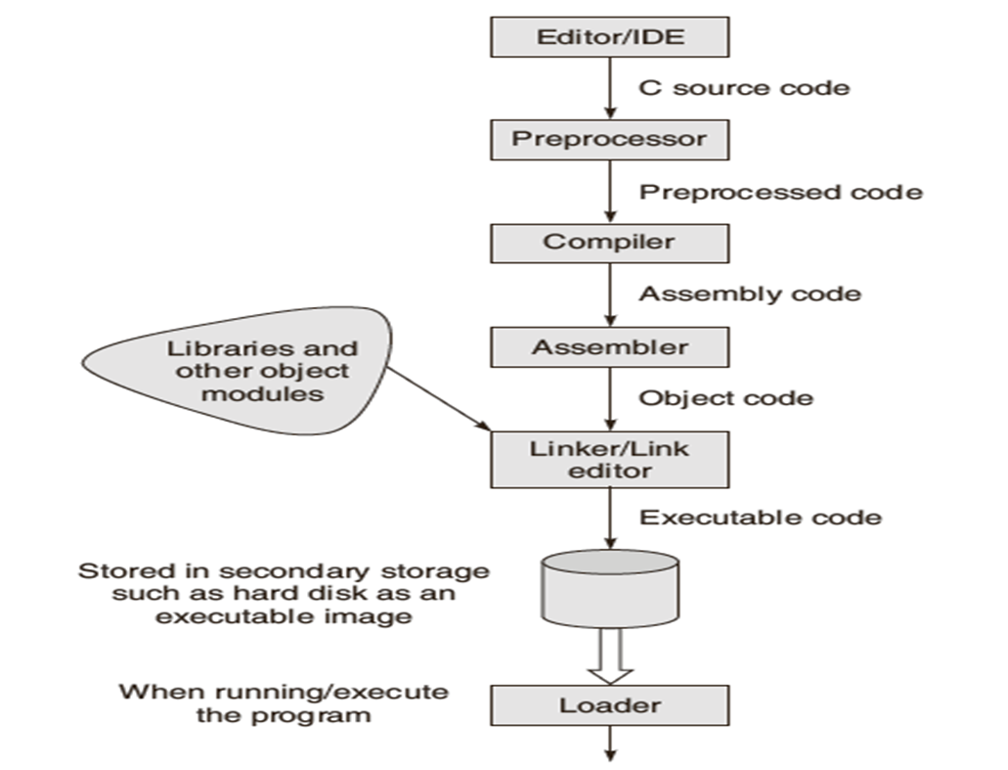
DEVELOPING PROGRAMS IN C

Slide 46
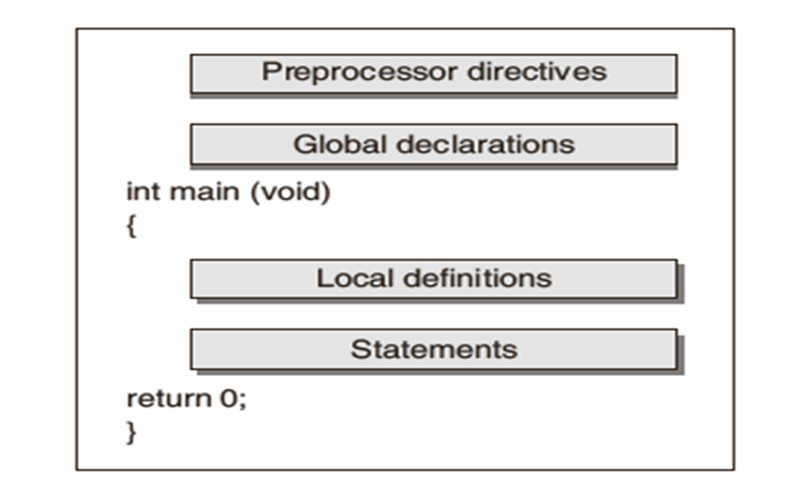
STRUCTURE : C PROGRAM

Slide 47
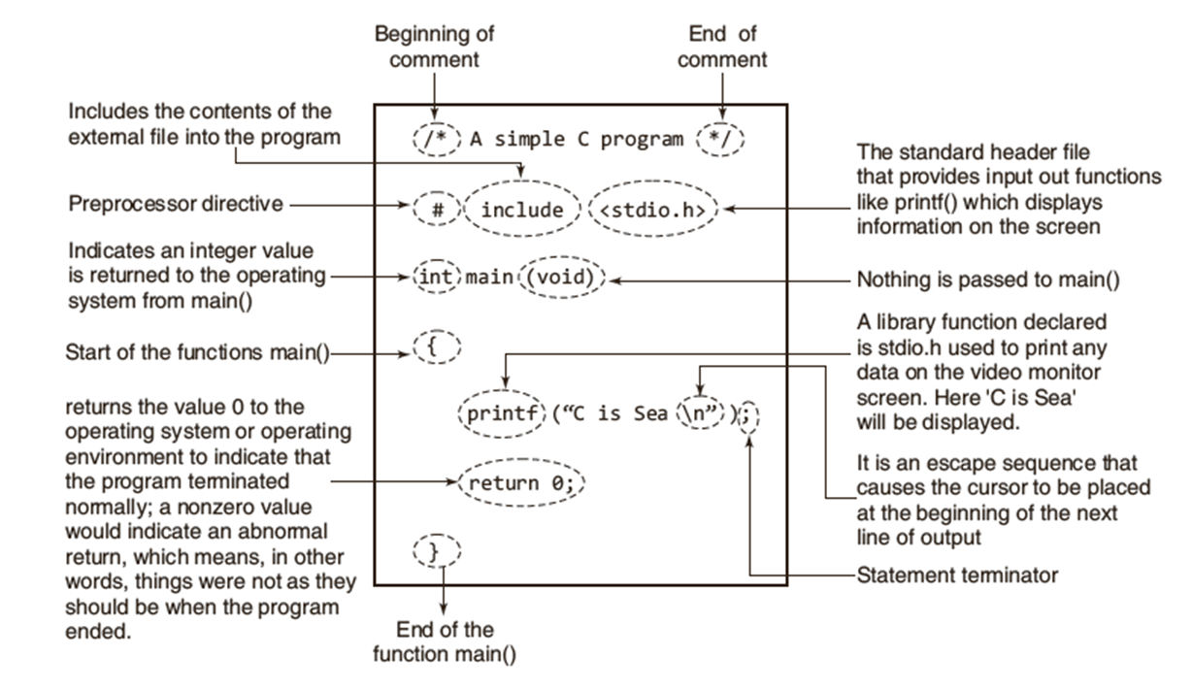
ILLUSTRATED VERSION OF A PROGRAM

Slide 48
VARIABLES
A variable is a container(storage area) to hold data.
All variables have three important attributes:
data type
name
value
Eg: int a = 10;
float b = 2.5;
char c = ‘f’;

Slide 49
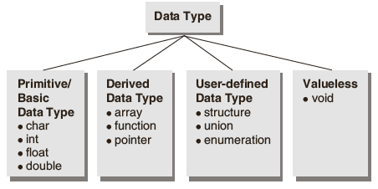
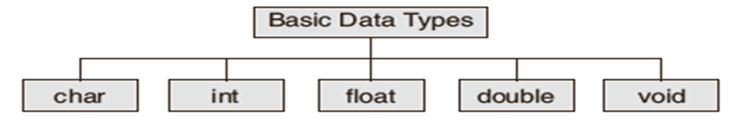
CLASSIFICATION :DATA TYPE

Slide 50
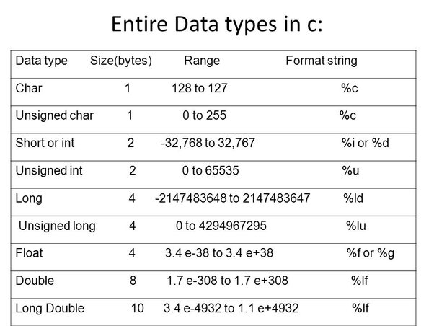
BASIC DATA TYPES:SIZE

Slide 51
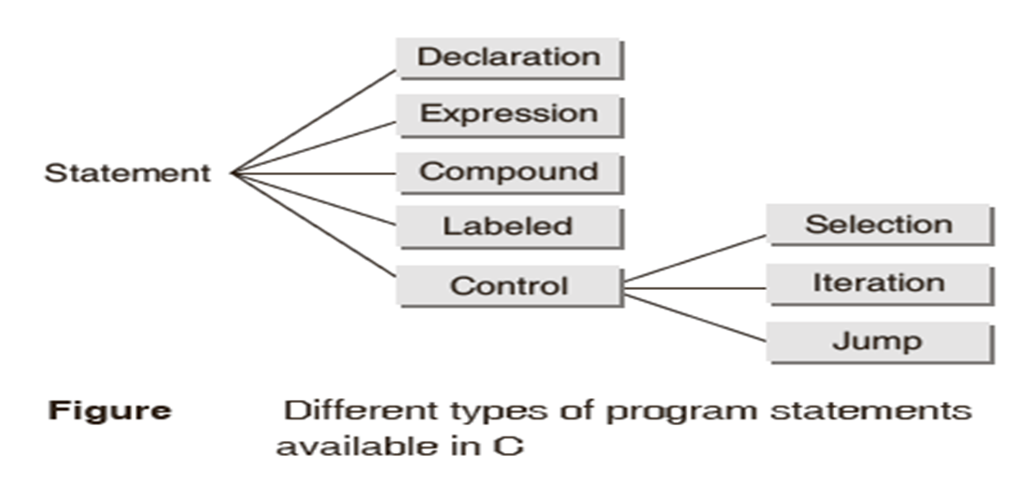
PROGRAM STATEMENTS
A statement is a syntactic construction that performs an action when a program is executed.
All C program statements are terminated with a semi-colon (;).

Slide 52
KEY WORDS
Keywords are system defined identifiers.
Keywords are reserved words.
They have specific meaning in the language and cannot be used by the programmer as a variable or constant name.
C is case sensitive.
32 Keywords.

Slide 53
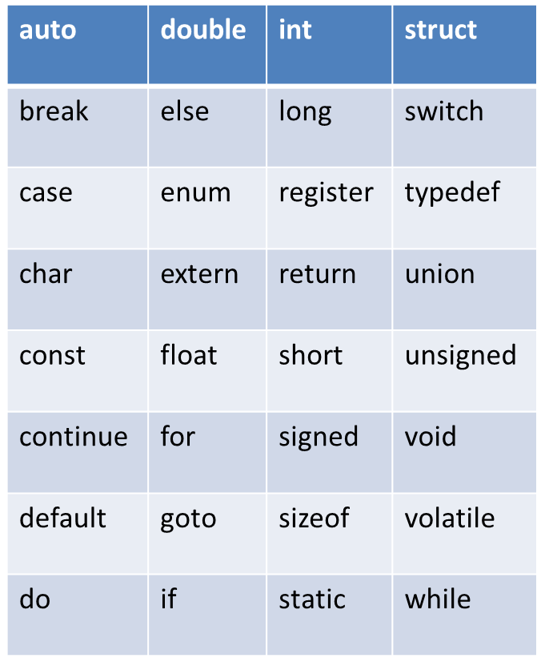
KEY WORDS

Slide 54
CONSTANT
A constant is a value or an identifier whose value cannot be altered in a program. For example: 1, 2.5
An identifier also can be defined as a constant. eg. const double PI = 3.14
Here, value of PI is a constant.

Slide 55
TYPES OF CONSTANTS
Integer constant eg: 1
Floating-point constant eg: 2.5
Character constant eg: ’a’
String constant eg: ”good”

Slide 56
Operators and Expressions
Operator: An operator is a symbol or letter used to indicate a specific operation on variables in a program.
Example: the symbol `+' is an add operator that adds two data items called operands.
Expression: An expression is a combination of operands (i.e., constants, variables, numbers) connected by operators and parentheses.
Example: In the expression given below, A and B are operands and `+' is an operator.
A + B

Slide 57
Operators and Expressions contd…
An expression that involves arithmetic operators is known as an arithmetic expression. The computed result of an arithmetic expression is always a numerical value.
An expression which involves relational and/or logical operators is called a boolean expression or logical expression. The computed result of such an expression is a logical value, i.e., either 1 (True) or 0 (False).

Slide 58
Rules for Formation of an Expression
A signed or unsigned constant or variable is an expression.
An expression connected by an operator to a variable or a constant is an expression.
Two expressions connected by an operator also form an expression.
Two operators should not occur in continuation.

Slide 59
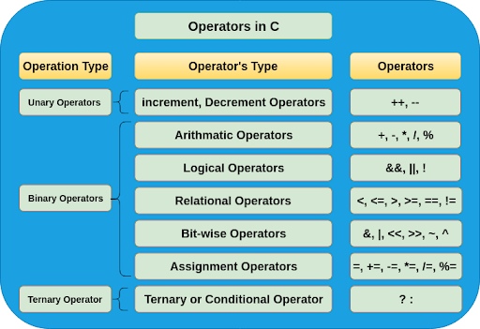
Types of Operators

Slide 60
Special Operators
Comma operator ( , )
sizeof operator – sizeof( )
Pointer operators – ( & and *)
Member selection operators – ( . and ->)

Slide 61
Arithmetic Operators
Operator | Meaning | Example 1 | Example 2
+ | Addition | 2+2=4 | 12+4.9 = 16.9
- | Subtraction | 5-3=2 | 3.98-4=-0.02
* | Multiplication | 2*5=10 | 2*3.4=6.8
/ | Division | 11/3=3 | 9/2.0=4.5
% | Modulo division | 11%3=2 | 13%2.5 (Error)
float
int

Slide 62
Variable implicit type conversion in expressions
When executing expressions of mixed types, C automatically converts integer to floating point and back again as needed.
int x = 1; x is declared an integer
x = x + 4.3 integer + floating point ??
x is converted to floating point
floating point addition
result is converted (truncated) back to integer for assignment (result is x = 5)

Slide 63
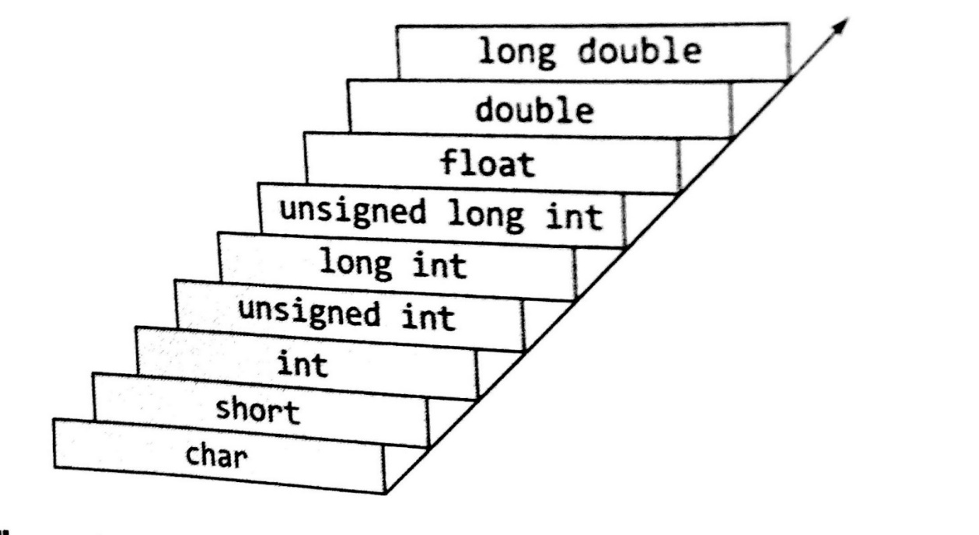
Promotion Hierarchy
Operands of the lower type can be implicitly converted to the higher type (in C)
Occurs when an operator expects the higher type (adding together two floats when one is an int)

Slide 64
Relational Operator
Operator | Meaning | Example | Return Value
> | Greater than | 5>4 | 1
< | Lesser than | 5<4 | 0
>= | Greater than or equal to | 5>=4 | 1
<= | Lesser than or equal to | 5<=4 | 0
!= | Not equal to | 5!=4 | 1
= = | Equal to | 5= =4 | 0
Used to compare two values and the result of such operation is always logical, i.e., either true or false.
Relational operators evaluate to 1, representing the true outcome, or 0, representing the false outcome

Slide 65
Logical Operators
C provides three logical operators for forming logical expressions.
Like the relational operators, logical operators evaluate to 1 or 0.
Operator | Meaning | Example | Return Value
&& | Logical AND | 5>4 && 6<9 | 1
|| | Logical OR | 5<4 || 6<9 | 1
! | Logical NOT | ! (5>=5) | 0

Slide 66
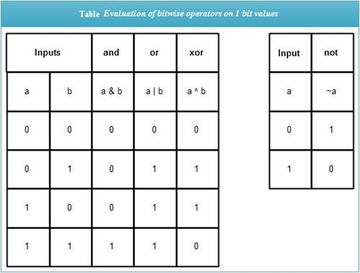
Bitwise – and , or, xor, not

Slide 67
Bitwise Operators
Bitwise operators are used for the manipulation of integer data items at bit level.
Operator | Meaning | Example | Answer | Explanation
& | Bitwise AND | 8&4 | 0 | 1000 & 0100 = 0000
| | Bitwise OR | 8|4 | 12 | 1000 | 0100 = 1100
^ | Bitwise XOR | 8^2 | 10 | 1000 ^ 0010 = 1010
~ | One’s complement | ~8 | 7 | 1000 = 0111
>> | Right Shift | 8>>2 | 2 | 1000 >>2 =0010
<< | Left Shift | 2<<3 | 16 | 0010<<3 = 10000
>> - n=y/2^s
<< - n=y*2^s
one’s complement operator is a unary operator
For any integer n, bitwise one’s complement of n will be -(n+1)

Slide 68
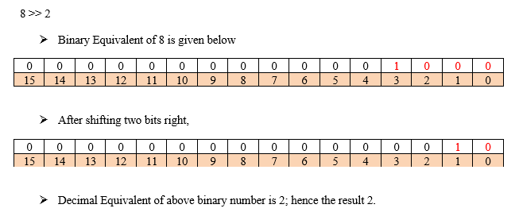
Right Shift - Example

Slide 69
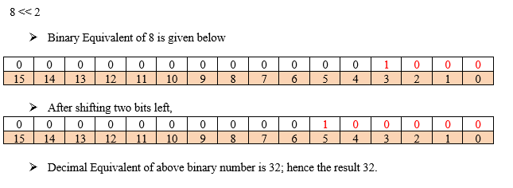
Left Shift - Example

Slide 70
Lvalue and Rvalue
Lvalue
Refers to a location in memory
It can appear both on the left and right side of an assignment statement
Rvalue
Refers to a data value
It can appear on the right side of an assignment statement and not on the left side.

Slide 71
Assignment Operators
Operator | Category | Example | Meaning
= | Simple Assignment | x=5 | x=5
+= | Compound Assignment | x+=5 | x=x+5
-= |  | x-=5 | x=x-5
*= |  | x*=5 | x=x*5
/= |  | x/=5 | x=x/5
%= |  | x%=5 | x=x%5
&= |  | x&=5 | x=x&5
^= |  | x^=5 | x=x^5
|= |  | x|=5 | x=x|5
>>= |  | x>>=2 | x=x>>2
<<= |  | x<<=2 | x=x<<2

Slide 72
Unary Operators
A unary operator requires only one operand or data item.
Unary increment and decrement operators :The unary ‘++’ and ‘--’ operators increment or decrement the value in a variable by 1.
Operator | Meaning | Example
+ | Plus | a=+10
- | Minus | a=-10
++ | Increment | x=++y
-- | Decrement | x=--y

Slide 73
Increment and Decrement operators
They require Lvalue to perform the operation and they don’t work on Rvalue.
Lvalue
Refers to a location in memory
It can appear both on the left and right side of an assignment statement
Rvalue
Refers to a data value
It can appear on the right side of an assignment statement and not on the left side.

Slide 74
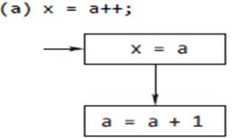
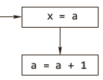
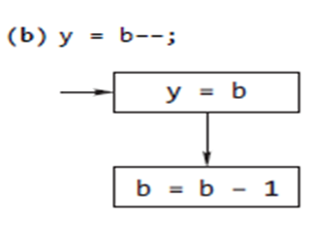
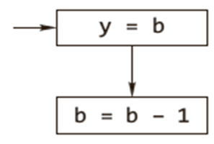
Post increment and decrement operators
First action : Store the value of a in the variable x
Second Action : Increment value of a by 1 and store the result in the variable a
First Action : Put value of b in the variable y
Second Action : Decrement value of b by 1 and put result in the variable b

Slide 75
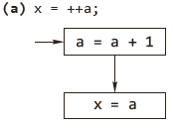
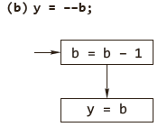
Pre increment and decrement operators
First action: increment value of a by 1 and store result in the variable a.
Second action: store value of a in the variable x.
First action: decrement value of b by 1 and store result in the variable b.
Second action: store value of b in the variable y.

Slide 76
pre- and post-increment - Example
#include<stdio.h>
void main()
{
int x,y;
x=10;
y=12;
x=y++;
++x;
printf("x=%d\t y=%d",x,y);
}
Output
x=13 y=13

Slide 77
Comma Operator
The comma operator is used to bring together a number of expressions which are performed in a sequence from left to right. For example, the following statement
a = (x = 5, x + 2);
executes in the following order:
(i) value 5 is assigned to variable x.
(ii) x is incremented by 2.
(iii) the value of expression x + 2 (i.e. 7) is assigned to the variable a.
The following points may be noted regarding comma operators.
A list of expressions, separated by comma, is always evaluated from left to right.
The comma operator has the lowest precedence among all C operators.

Slide 78
Size of Operator
sizeof - calculates the size of any data item or type.
It takes a single operand that may be a type name (e.g., int) or an expression (e.g.,100) and returns the size of the specified entity in bytes .
The outcome is totally machine-dependent.
If sizeof() holds an expression, it doesn’t get evaluated.
sizeof is the only operator which is also a keyword.

Slide 79
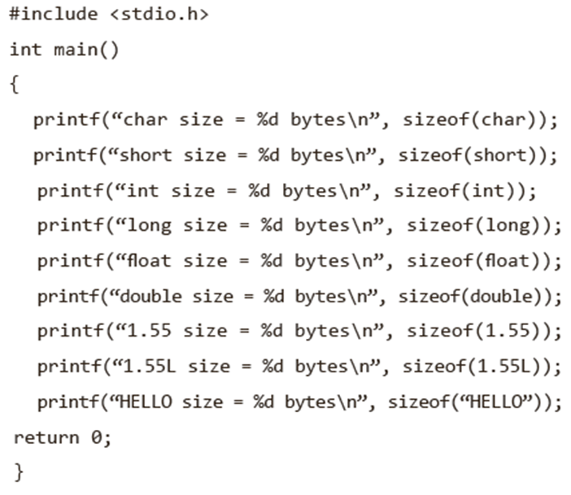
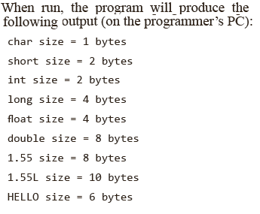
Size of Operator - Example

Slide 80
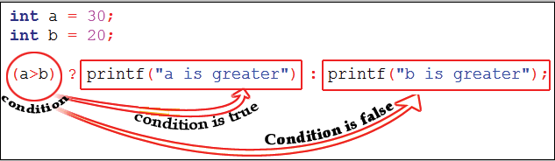
Ternary Operator
The operator using three operands or three variables is known as Ternary Operator
Conditional Operator (? :) is a Ternary Operator
Syntax
expression-1 ? expression-2 : expression-3
In the above syntax, expression-1 is condition and expression-2 and expression-3 will be either value or variable or statement or any mathematical expression
Example:
int a=30, b = 20;
a>b ? printf (“a is greater") : printf (“b is greater");
Answer:
a is greater

Slide 81
Ternary Operator - Example
#include<stdio.h>
void main()
{
int n;
printf("Enter an integer:");
scanf("%d",&n);
(n% 2 == 0) ? printf("\n%d is a Even number\n",n) : printf("\n%d is a Odd number\n",n);
}
Case 1
n=5
n% 2 != 0 hence expression 3 will get executed
Output: 5 is a Odd number
Case 2
n=6
n% 2 == 0 hence expression 2 will get executed
Output: 6 is a Even number

Slide 82
Ternary operator - Nested
#include<stdio.h>
int main()
{
int k, num=30;
k = (num>5 ? (num <=10 ? 100 : 200): 500);
printf("%d\n", k);
return 0;
}
Output:
200

Slide 83
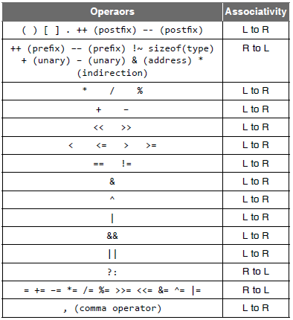
Expression Evaluation— Precedence and Associativity

Slide 84
Example: operator precedence
#include<stdio.h>
int main() {
int num1 = 10, num2 = 20;
int result;
result = num1 * 2 + num2;
printf("\nResult is : %d", result);
return (0);
}
Explanation :
Step 1 : result = num1 * 2 + num2;
Step 2 : result = 10 * 2 + 20;
Step 3 : result = 20 + 20;
Step 4 : result = 40;

Slide 85
Example: operator associativity
#include<stdio.h>
int main() {
int num1 = 10, num2 = 20;
int result;
result = num1 * 2 + num2 * 2 ;
printf("\nResult is : %d", result);
return (0);
}
Explanation :
result = num1 * 2 + num2 * 2 ;
result = 10 * 2 + 20 * 2 ;
result = 20 + 20 * 2 ;
result = 20 + 40 ;
result = 60 ;

Slide 86
Data Input and Output
The I/O library functions are listed in the “header” file <stdio.h>.
Types:
Unformatted Input/output functions
Formatted Input/output functions

Slide 87
Unformatted Input/output functions
Input functions
gets()
getchar()
getch()
getche()
Output functions
puts()
putchar()
putch()
puts()

Slide 88
getchar()
Reads a single character from the input data stream; but does not return the character to the program until the ‘\n’ ( or ) enter key is pressed.
Syntax:-
variable = getchar();
Example:-
char c;
c = getchar();
Program
#include<stdio.h>
void main()
{
char c;
printf(“Enter a character”);
c=getchar();
printf(“c = %c ”,c);
}
Output
Enter a character k
c = k

Slide 89
getch() and getche()
These functions read any alphanumeric character from the standard input device
The character entered is not displayed by the getch() function until enter is pressed
The getche() accepts and displays the character.
The getch() accepts but does not display the character.
Syntax:
getche();
getch();

Slide 90
getch() and getche() - Program
#include<stdio.h>
void main()
{
printf(“Enter two alphabets:”);
getche();
getch();
}
Output
Enter two alphabets a b
a

Slide 91
putchar()
This function prints one character on the screen at a time which is read by standard input.
Syntax:
putchar( variable name);
Example:
char c= ‘c’;
putchar(c);
#include<stdio.h>
void main()
{
char ch;
printf(“Enter a character: ”);
scanf(“%c”, ch);
putchar(ch);
}
Output
Enter a character: r
r

Slide 92
putch()
Program
#include<stdio.h>
void main()
{
char ch;
printf(“Press any key to continue”);
ch = getch();
printf(“ you pressed:”);
putch(ch);
}
Output:
Press any key to continue
You pressed : e
This function prints any alphanumeric character taken by the standard input device
Syntax:
putch( variable name);
Example:
char c= ‘c’;
putch(c);

Slide 93
gets()
String I/O
This function is used for accepting any string( stream of characters) until enter key is pressed
Syntax
char str[length of string in number];
gets(str);
Example:
char name[15];
gets(name);
Program
#include<stdio.h>
void main()
{
char ch[30];
printf(“Enter the string:”);
gets(ch);
printf(“Entered string: %s”, ch);
}
Output:
Enter the string: Use of data!
Entered string: Use of data!

Slide 94
puts()
This function prints the string or character array.
It is opposite to gets()
Syntax
char str[length of string in number];
gets(str);
puts(str);
Program
#include<stdio.h>
void main()
{
char ch[30];
printf(“Enter the string:”);
gets(ch);
puts(“Entered string:”);
puts(ch);
}
Output:
Enter the string: puts is in use
Entered string: puts is in use

Slide 95
Formatted Input and Output Functions
scanf() - input function
printf() - output function

Slide 96
printf()
Output function
General form:
printf(“control_string or format specifier”,variable1,variable2, variable3,...);
Example: printf(“The numbers are %d and %d”,number1,number2);

Slide 97
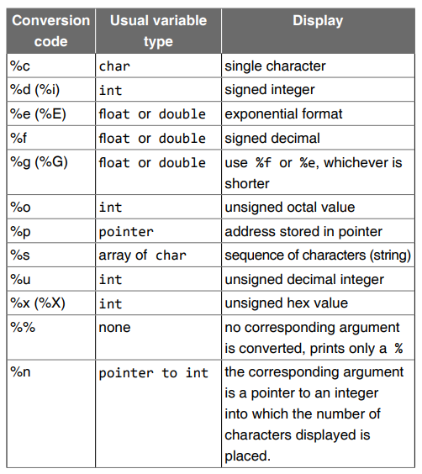
Format Specifiers

Slide 98
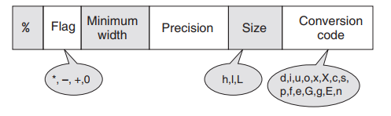
Parts of conversion specifier field for printf()
The percent sign and conversion code are required
Other modifiers such as width and precision are optional.
width specifies the total number of characters used to display the value
precision indicates the number of characters used after the decimal point. The precision option is only used with floats or strings.
Default precision value is 6

Slide 99
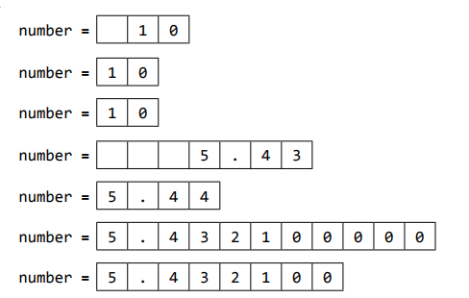
Examples
printf(“number=%3d\n”, 10); printf(“number=%2d\n”, 10); printf(“number=%1d\n”, 10); printf(“number=%7.2f\n”, 5.4321); printf(“number=%.2f\n”, 5.4391); printf(“number=%.9f\n”, 5.4321); printf(“number=%f\n”, 5.4321);

Slide 100
Flag characters used in printf()
Flag | Meaning
- | Left justify the display
+ | Display positive or negative sign of value
Space | Display space if there is no sign
0 | Pad with leading zeros
# | Use alternate form of specifier

Slide 101

Example
printf(“number=%06.1f\n”, 5.5); printf(“%-+6.1f=number\n”, 5.5);

Slide 102
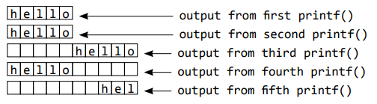
Example with strings
#include<stdio.h>
int main()
{
printf(“%s”,“hello”);
printf(“\n%3s”,“hello”);
printf(“\n%10s”,“hello”);
printf(“\n%-10s”,“hello”);
printf(“\n%10.3s”,“hello”);
return 0;
}

Slide 103
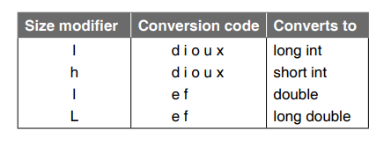
Size modifiers used in printf()

Slide 104
scanf()
General form:
scanf(“control_string”,variable1_address, variable2_address,...);
scanf() returns the number of input fields successfully scanned, converted, and stored
Example:
scanf(“%d%d’,&num1,&num2);

Slide 105
Controls
Also called as control constructs
Need
Select between optional sections of a program
Repeat certain sections of a program.
True and False representation
False: value 0 is considered as false
True: Any value other than 0 is considered as true

Slide 106
Types
Program control statements/Constructs
Selection/ Branching
switch
Iteration/Looping
else if ladder
if else
if
while
for
do while

Slide 107
if statement
Test Condition
True
One – way decision / branching
The ‘statements’ can be any valid C language statement
‘condition’ is any valid C’ language expression, often logical operators are used in the condition statement
If the condition is true then perform
the following statement or if the condition
is false the computer skips the statement
and moves on to the next instruction
in the program
Syntax:
if(condition)
{
statement(s);
}
statement(s)
False
False
rest of the code

Slide 108
if statement - Example
#include<stdio.h>
void main()
{
int number;
printf("Enter a number:");
scanf("%d", &number);
if(number<0)
number= -number;
printf("The absolute value is %d",number);
}
Output
Case 1:
Enter a number: -10
The absolute value is 10
Case 2:
Enter a number: 9
The absolute value is 9

Slide 109
if-else statement
Syntax:
if ( condition)
{ statement(s)_1;
}
else
{
statement(s)_2;
}
Test Condition
Two-way decision / branching
If the result of the condition is true, then program statement(s)_1 is executed, otherwise program statement(s)_2 will be executed
False
True
statement(s)
statement(s)

Slide 110
if else statement - Example
#include <stdio.h>
void main()
{
int number;
printf("Type a non zero number:");
scanf("%d",&number);
if(number>0)
printf("\nThe number is positive");
else
printf("\nThe number is negative");
}
Output
Case 1:
Type a non zero number: 60
The number is positive
Case 2:
Type a non zero number: -13
The number is negative

Slide 111
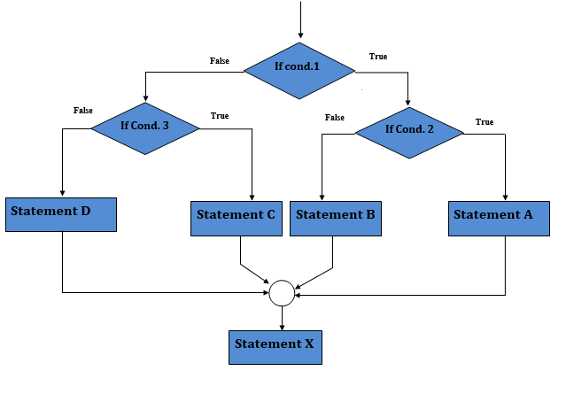
Nested if-else Statement
We can write an entire if…else statement in another if…else statement called nesting
Syntax:
if (condition1) {
statement(s);
if (condition2) { statement(s); }
else { statement(s); }
}
else {
statement(s);
if (condition2) { statement(s); }
else { statement(s); }
}

Slide 112
Nested if-else Statement - Example
#include<stdio.h>
void main()
{
int a,b,c,big;
printf("Enter three different numbers:");
scanf("%d%d%d",&a,&b,&c);
if (a>b)
if(a>c)
big = a;
else
big = c;
else
if (b>c)
big = b;
else
big = c;
printf("Largest of %d %d %d is %d",a,b,c,big);
}
Output:
Enter three different numbers:56 78 40
Largest of 56 78 40 is 78

Slide 113
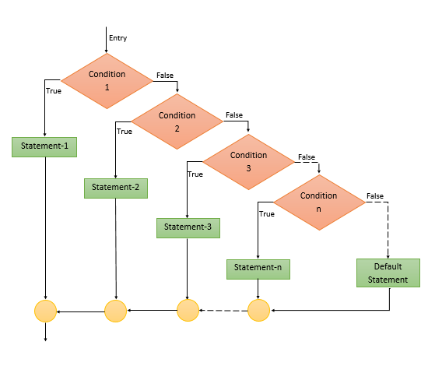
The else if ladder
Multiway decision or
branching statement
Syntax
if (condition_1)
{ statement(s)_1;
} else if (condition_2)
{ statement(s)_2;
} .
.
. else if (condition_n)
{ statement(s)_n;
} else
{ statement(s)_default;
}

Slide 114
The else if ladder - Example
Output
Case 1:
Enter marks: 85
Distinction
Case 2:
Enter marks: 55
Second class
Case 3:
Enter marks: 20
Fail
#include <stdio.h>
void main()
{
int marks;
printf ("Enter marks:");
scanf ("%d", &marks);
if (marks <= 100 && marks >= 70)
printf ("\nDistinction");
else if (marks >= 60)
printf("\nFirst class");
else if (marks >= 50)
printf ("\nSecond class");
else if (marks >= 35)
printf ("\nPass class");
else
printf ("Fail");
}

Slide 115
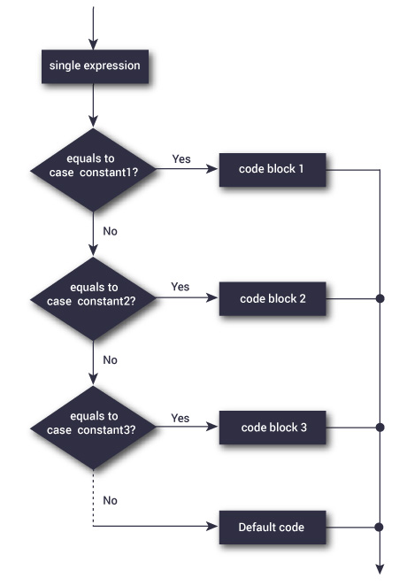
Switch Statement
Multiway decision or branching statement
Syntax
switch (expression) { case label-1: statement(s); break; case label-2: statement(s); break; case label-n: statement(s); break; ……………… default: statement(s); }

Slide 116
Switch Statement Contd…
Allows a program to select one statement block for execution, out of a set of alternatives.
It checks for equality among the expression and the case value.
A switch may occur within another switch, but it is rarely done. Such statements are called as nested switch statements.
The switch statement is very useful while writing menu driven programs.

Slide 117
switch statement - Rules
The result of the expression in the switch statement must be an integer or character constant.
No real numbers are used in an expression.
The default is optional and can be placed anywhere, but usually placed at end.
The case keyword must be terminated with colon (:);
Case value specified in switch must be unique. i.e., No two case constant can be identical.
The values of switch expression is compared with case constant in the order specified i.e from top to bottom.
To denote the end of a particular case statement, break statement must be used.
Without break statement, the control flows from one case to the consecutive case
With break the control will go to the next statement after current switch block
For compound statements there is no need to enclose within pair of braces.

Slide 118
Switch Statement- Example
#include <stdio.h>
void main ()
{
int num1, num2, result;
char operator;
printf ("Enter two numbers");
scanf ("%d %d", &num1, &num2);
printf ("Enter an operator") ;
scanf ("%c", &operator)
switch (operator)
{
case '+':
result = num1 + num2;
break;
case '-':
result = num1 - num2;
break;
case '*':
result = num1 * num2;
break;
case '/':
if (num2 != 0)
result = num1 / num2;
else
{
printf ("warning : division by zero \n");
result = 0;
}
break;
default:
printf ("\n unknown operator");
result = 0;
}
printf ("%d", result) ;
}

Slide 119
Switch Statement- Example
#include <stdio.h>
void main ()
{
int number;
printf ("Enter a number");
scanf ("%d",&number);
switch(number%2)
{
case 0:
printf("Even");
break;
case 1:
printf("Odd");
break;
}
}

Slide 120
Difference between nested if else and switch statements
Nested if else | switch
if-else statement can check any condition like equal to, less than, greater than or equal to, not equal to, etc .. | switch statement can check only for equality
Expression in if-else can result to a value of any data type | Expression in switch should result to either int data type or char data type value
More than one similar condition can be specified in if-else | Case value specified in switch must be unique
else statement at the end can be used to denote any condition other than specified previously. | default case can be used to denote any value other than specified previously

Slide 121
Structured Programming: Control Statements –Looping control statements, break, continue, goto statements

Slide 122
Looping / Iteration
Loop - A segment of the program that is executed repeatedly
Some portion of the program needs to be specified several number of times or until a particular condition is satisfied.
Types of looping statements in C
while loop
do…while loop
for loop

Slide 123
Looping / Iteration – contd…
Two parts:
Control expressions: One or more control expressions which control the execution of the loop
Body : which is the statement or set of statements which is executed over and over
Steps
Initialization of a condition variable
Test the control statement
Executing the body of the loop depending on the condition
Updating the condition variable

Slide 124
while statement
Syntax
while (expression/condition) { body of the loop; }
Start
Entry controlled loop statement
Expression or condition is evaluated, and the body of the loop is executed until the expression or condition becomes false.
When the expression or condition becomes false, the control is transferred out of the loop.
Initialize
Test Condition
False
Stop
True
Body of Loop
updation of the control variable

Slide 125
while Statement - Example
Program for generating ‘N’ Natural numbers using while loop:
#include<stdio.h>
void main()
{
int n, i=0;
printf("Enter the upper limit number:");
scanf("%d",&n);
while(i <= n)
{
printf(“\n%d",i);
i++;
}
}
Output:
Enter the upper limit number:6
0
1
2
3
4
5
6

Slide 126
do-while statement
Start
Syntax
do { body of the loop; } while(expression/condition);
Exit controlled loop statement
The statements in the body of the loop is executed first, then expression or condition is evaluated
If the condition or expression is true, then the body of the loop is executed again, and this process continues till the condition or expression becomes false
When the expression becomes false, the loop terminates, and the control is transferred out of the loop
Note: do while ends in a ; (semicolon)
Initialize
Body of Loop
updation of the control variable
Test Condition
True
False
Stop

Slide 127
do-while statement - Example
/* Program to illustrate the do-while loop*/
#include<stdio.h>
void main()
{
char inchar;
do
{
printf("Input y or n\n");
scanf(" %c",&inchar);
}while(inchar!='y' && inchar != 'n');
if(inchar=='y')
printf("you pressed y\n");
else
printf("You pressed n\n");
}
Output:
Input y or n
a
Input y or n
b
Input y or n
r
Input y or n
y
you pressed y

Slide 128
while and do…while statement
while | do…while
entry controlled | exit controlled
Tests the condition before each iteration | Tests the condition after the first iteration.
If the condition fails initially, the loop is skipped entirely even in the first iteration. | Even if the condition fails initially, the body loop is executed once.

Slide 129
for loop
Used to execute a set of instructions repeatedly until the expression or condition becomes false.
Start
Syntax:
for (initialization; expression /condition; updation of control variable) { body of the loop ; }
Initialize
Test Condition
False
Stop
True
Body of Loop
updation of the control variable

Slide 130
for loop – Example
#include<stdio.h>
void main()
{
int i;
int sum=0,sum_of_squares=0;
for(i=0; i<=30; i+=2)
{
sum+=i;
sum_of_squares +=i*i;
}
printf("Sum of first 15 positive even numbers=%d\n",sum);
printf("Sum of their squares=%d\n",sum_of_squares);
}
Output:
Sum of first 15 positive even numbers=240
Sum of their squares=4960

Slide 131
Additional Features of for Loop
Case 1:
The statement
p = 1;
for (n = 0; n < 17; ++ n)
can be rewritten as
for (p = 1, n = 0; n < 17;++n)
Case 2:
The test – condition may have any compound relation and the testing need not be limited only to the loop control variable.
sum = 0;
for (i = 1; i < 20 && sum < 100; ++ i)
{
sum = sum + i;
printf(“%d %d\n”, i, sum);
}

Slide 132
Additional Features of for Loop Contd…
Case 3:
It is also permissible to use expressions in the assignment statements of initialization andupdation sections.
For Example:
for (x = (m + n) / 2; x > 0; x = x / 2)
Case 4:
Another unique aspect of for loop is that one or more sections can be omitted, if necessary.
For Example:
m = 5;
for ( ; m ! = 100 ;) {
printf(“%d\n”,m);
m = m + 5;
}
for(;;) – Infinite loop
Note: Both the initialization and increment sections are omitted in this for statement. The initialization has been done before the for statement and the control variable is incremented inside the loop. In such cases, the sections are left ‘blank’. However, the semicolons separating the sections must remain. If the test – condition is not present, then the for statement sets up an ‘infinite’ loop. Such loops can be broken using break or goto statements in the loop.

Slide 133
Additional Features of for Loop Contd…
Case 5:
We can set up time delay loops using the null statement as follows:
for ( j = 1000; j > 0; j = j – 1)
;
This loop is executed 1000 times without producing any output; it simply causes a time delay.
Notice that the body of the loop contains only a semicolon, known as a null statement.
Case 6:
for ( j = 1000; j > 0; j = j – 1);
This implies that the C compiler will not give an error message if we place a semicolon by mistake (or consciously as in the case 5) at the end of a for statement. The semicolon will be considered as a null statement.

Slide 134
Nested loops
Syntax:
Outer_loop
{
Inner_loop
{
// inner loop statements.
}
// outer loop statements.
}
The looping of statements inside another loop
Any number of loops can be defined inside another loop
Any type of loops can be defined inside another loop

Slide 135
Nested loops - Example
while(condition)
{
do
{
inner loop statement(s);
}
while(condition) ;
outer loop statement(s);
}
for(initialization;condition; updation)
{
while(condition)
{
inner loop statement(s);
}
outer loop statement(s);
}

Slide 136
break and continue statements
The break statement is used to break any type of loop (while, do-while and for loop) or case in a switch statements
break statement terminates the loop body immediately
The break statement causes the control to transfer out of the entire switch statement.
The continue statement is used to break the current iteration of the loop by skipping the remaining part of the loop
After continue statement, the control returns to the start of the loop for next iteration
Both break and continue statements does not have any embedded expression or arguments.

Slide 137
break - Example
#include<stdio.h>
void main()
{
int i;
for(i=0; i<10;i++)
{
if(i==4)
break;
printf("%d\n", i);
}
}
This program comes out of the loop when i equals 4
Output:
0
1
2
3

Slide 138
continue - Example
#include<stdio.h>
void main()
{
int i=0;
while(i<10)
{
if(i==4)
{
i++;
continue;
}
printf("%d\n",i);
i=i+1;
}
}
Output:
0
1
2
3
5
6
7
8
9

Slide 139
break and continue - Difference
break | continue
It is used in loop and switch case | It is used in loops and not in switch case
It is used to terminate from the loop | It is used to continue to the next iteration in the loop
Control is transferred outside the loop | Control remains in the same loop

Slide 140
goto statement
The goto statement is used to transfer the program control unconditionally from one statement to another statement
A statement label is used which is followed by colon ( : )
Types
Unconditional goto
Conditional goto
Syntax:
goto <<label_name>>;
…..
…..
label:
statement(s);

Slide 141
goto statement - Example
conditional goto
unconditional goto
The control transfers from one block to another block with checking the test condition.
#include<stdio.h>
void main()
{
int n, sum = 0, i = 0;
printf ("Enter a number:");
scanf ("%d", &n);
loop:
i++;
sum += i;
if (i < n) goto loop;
printf ("\nSum of first %d natural numbers = %d", n, sum);
}
The control transfers from one block to another block without checking the test condition.
#include <stdio.h>
main()
{
Start:
printf("Welcome\n");
goto Start;
}

